Slide 1
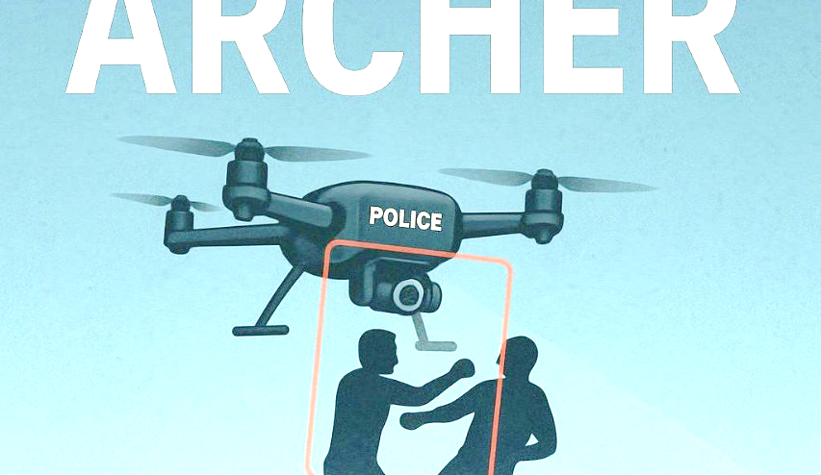
Active Response & Control Hub for Emergency Reconnaissance -:
ARCHER➵
Team – Flag Smashers

Slide 2
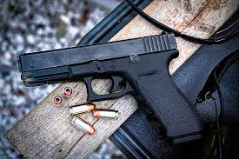
ARCHER
ISSUES
CHALLENGES
Delayed police response
No immediate on-ground intervention
Unreported or unnoticed crimes
Human surveillance limitations
Inefficient emergency call handling
High crime in unmonitored zones
Next

Slide 3
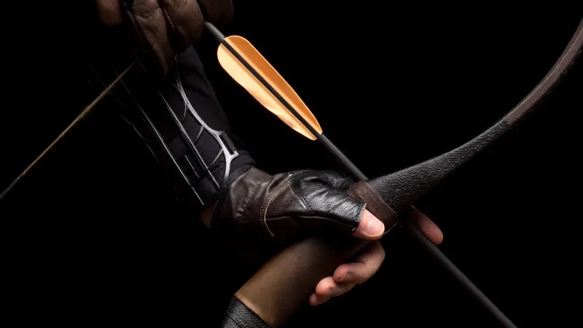

ARCHER?
(Active Response & Control Hub for Emergency Reconnaissance)
A modular AI-as-a-Service platform for real-time threat detection, behavior analysis, and emergency alerts.
This opens up to multi-platform use:
Drones
Ground vehicles
Surveillance cameras
Military handheld devices
Bullseye in Every Shot

Slide 4


Tech Stack :-
HARDWARE
SOFTWARE
Flight Controller
Transmitter Receiver
Open CV2
Flask
Electronic Speed Controllers
Motor Driver
YOLO V8L
Machine learning
BLDC Motors
Arduino
Motion Amplification
HTML,CSS,
JAVASCRIPT
Raspberry Pi 4
ESP32 CAM
And Lots of more interesting stuff…….

Slide 5
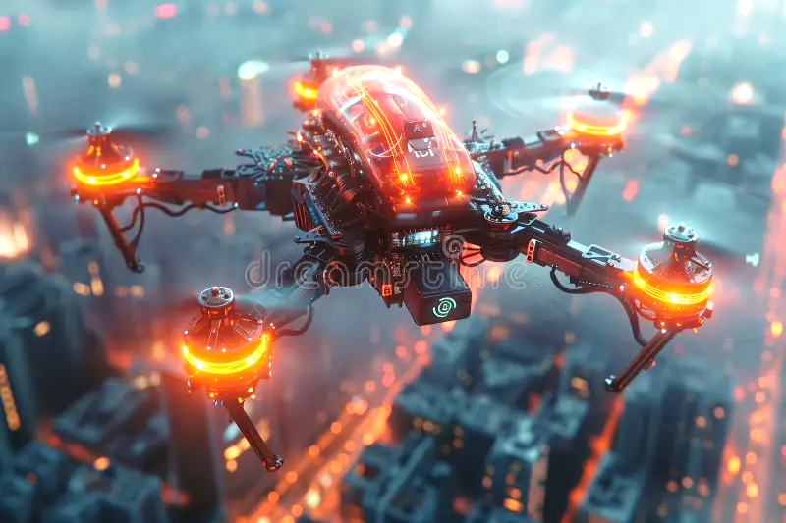
ARCHER
APPLICATIONS
Working of ARCHER:
1- A semiautonomous drone monitors over a radius of police station zone. 2- A operator at the police station keeps an eye on the visuals of drones through FPV mode (First Person View). 3- When the drone detects any crime or threats based on body movements of humans like punching, running, stabbing etc. with the help of artificial intelligence, it sends alerts on the operator’s screen. 4- Operator than confirms the visual as a possible threat and then notifies another operator. 5- Operator 2 then deploys a semiautonomous rover which then travels to the GPS coordinates of the drone and locks on the suspect.
6- The rover then tracks the suspect wherever he goes with the help of CV2.
6- Then operator has options to ask the suspect to kneel and surrender or shoot him with Taser or Pepper spray knocking him down until police arrives at the location.
7-The drone will charge on the roof of the zonal police station while the rover will have its own ground station on every 500 meters in the city to reach the crime location as quick as possible.
Next

Slide 6
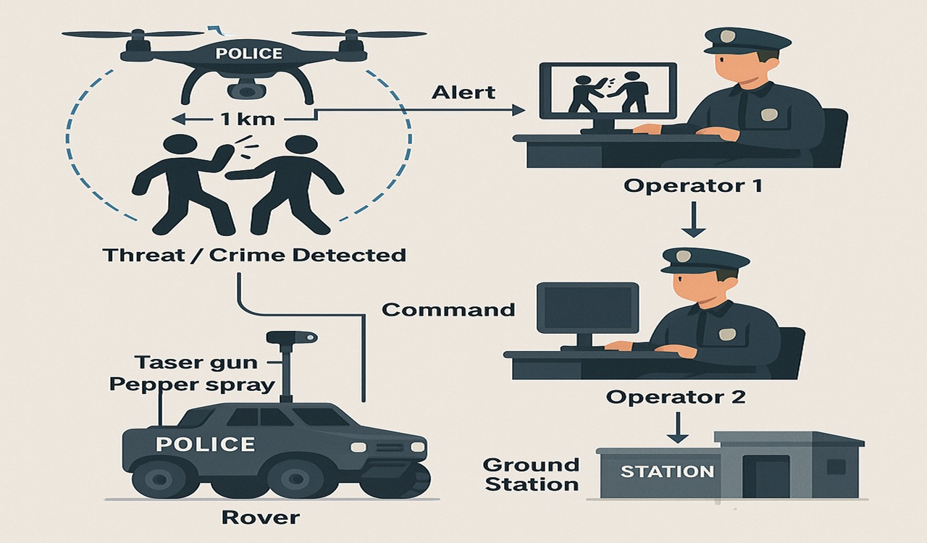

Slide 7
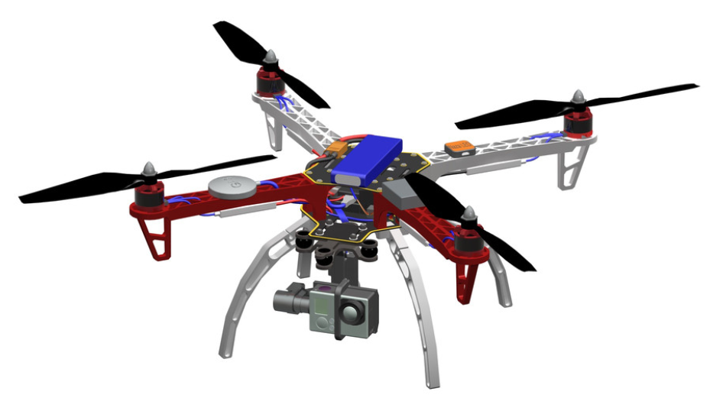
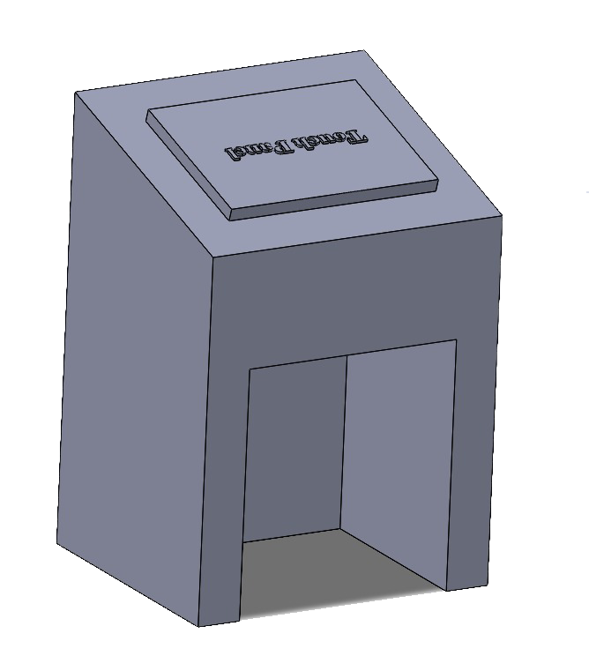
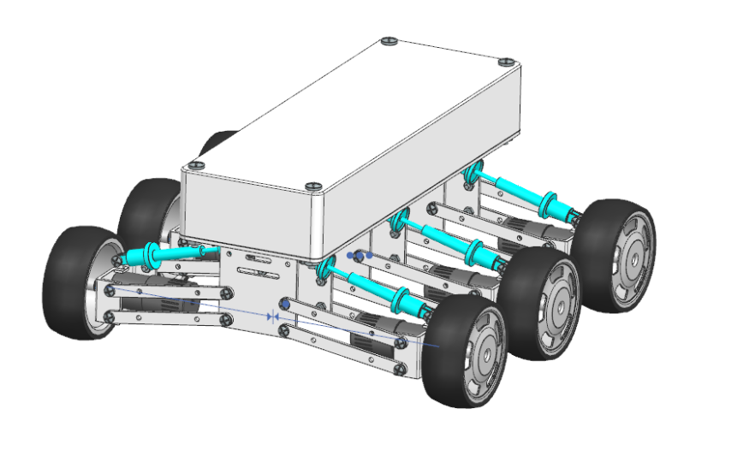
3-D Models-:
ARCHER GROUND STATION FOR ROVER
ARCHER DRONE
ARCHER ROVER

Slide 8
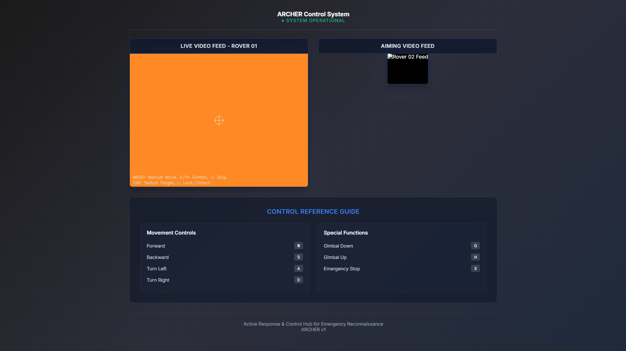
ROVER CONTROL PANEL

Slide 9
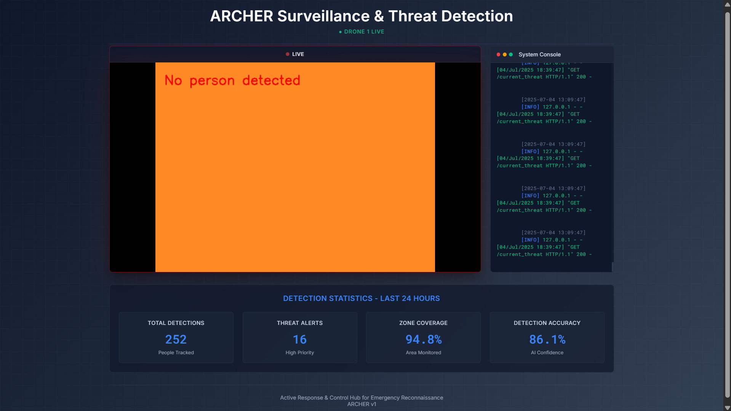
DRONE CONTROL PANEL

Slide 10
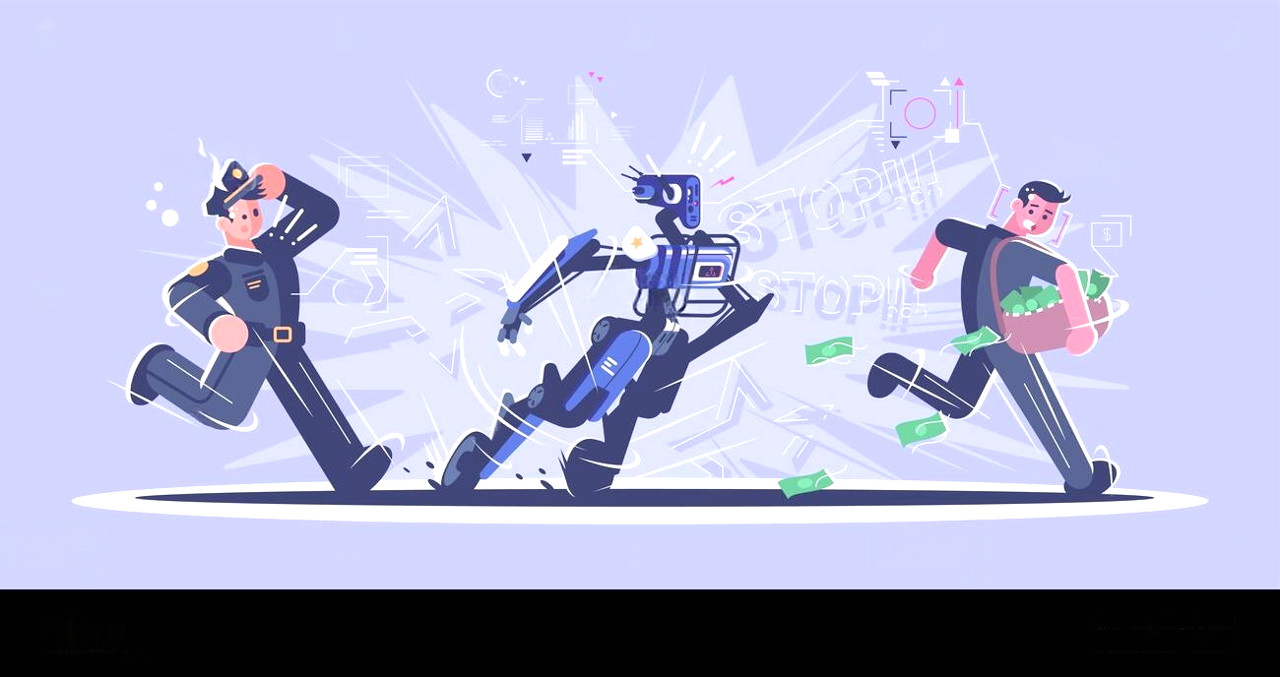
Solution and Benefits-:
Faster response time than traditional police dispatch
Crime deterrence through visible AI patrols
Reduced risk to human officers during initial response
24/7 autonomous monitoring with minimal manpower
Autonomous rover deployment from ground stations every 300m
Non-lethal threat engagement (taser, pepper spray)
Two-operator control system for safety and decision-making
Immediate help for victims before police arrive
Supports police, doesn’t replace—a true force multiplier

Slide 11

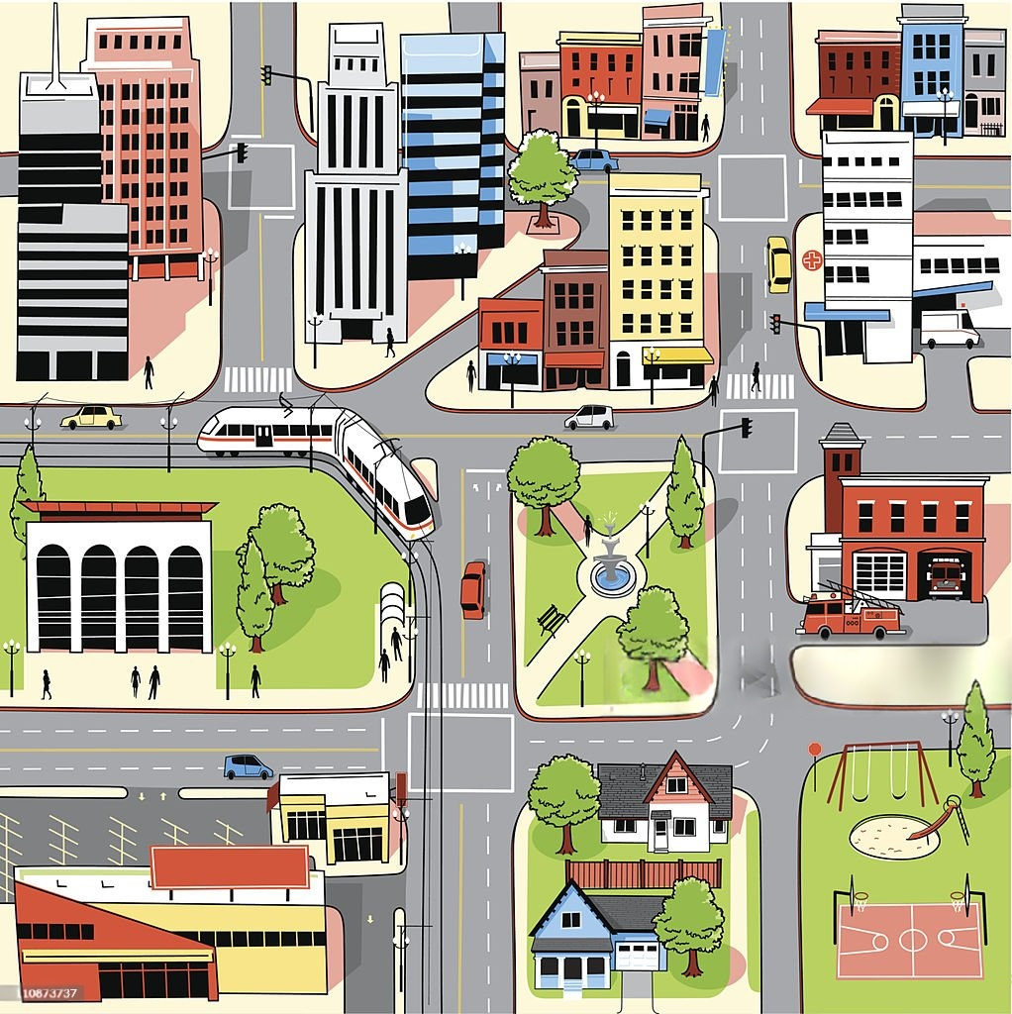
MARKET OPPORTUNITIES -:
Delayed Responses
Market Size
Police arrive 30+ minutes late in secluded areas.
100+ Tier-1 & Tier-2 cities in India.
Avg. 250 police stations per city.
Blind Spots
Estimated market: ₹1500–1700 Cr (hardware + annual services).
Crimes often go unnoticed in low-surveillance zones.
Business Model
Non-Intelligent Drones
One-time sale of Drone-Rover systems
Existing police drones only used for facial recognition during events.
Annual service contracts for maintenance, AI upgrades
Customers
City-wide mesh ensures no blind spots — drones at stations, rovers every 500m
Expansion into emergency & defense sectors
Police Departments, Urban City Governments, Smart City Programs.

Slide 12


